Slide 2
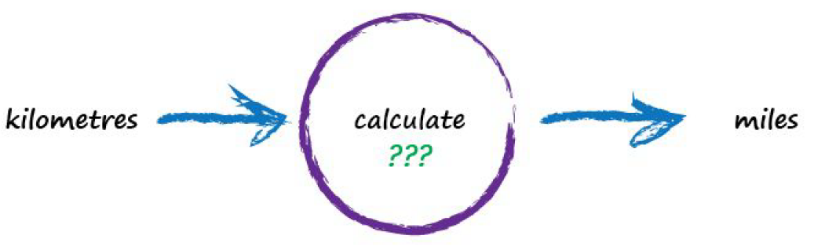
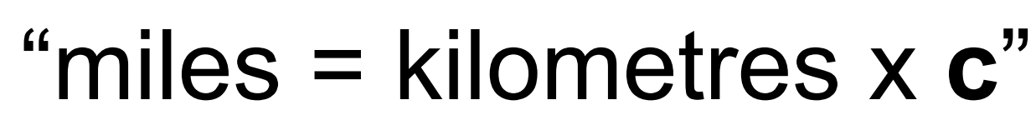
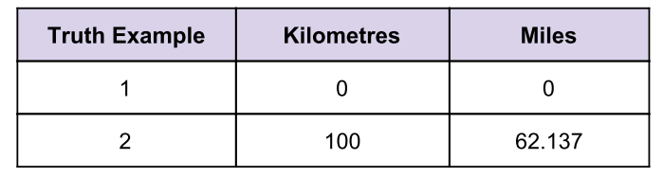
簡單的預測器
we don’t know the formula for converting between kilometres and miles
All we know is the the relationship between the two is linear
The only other clues we have are some examples pairing kilometres with the correct value for miles.

Slide 3
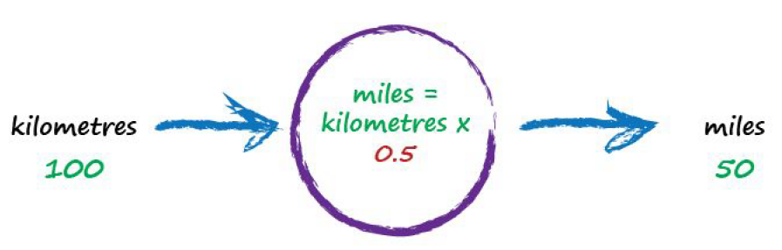
Let’s just pluck a value at random and give it a go!
try c = 0.5 and see what happens
That gives 50 miles
our truth example number 2 tells us the answer should be 62.137
We’re wrong by 12.137. That’s the error
So what next? We know we’re wrong, and by how much

Slide 4
we use this error to guide a second, better, guess

Slide 5
We were short by 12.137.
Because the formula for converting kilometres to miles is linear
we know that increasing c will increase the output
up from 0.5 to 0.6 and see what happens
we get miles = kilometres x c = 100 x 0.6 = 60.
the error is a much smaller 2.137.

Slide 6
The output of 60 is still too small.
Let’s nudge the value of c up again from 0.6 to 0.7.
We’ve gone too far and overshot the known correct answer.
Our previous error was 2.137 but now it’s ­-7.863

Slide 7
we nudge c up by just a tiny amount, from 0.6 to 0.61.
we have an output value of 61 which is only wrong by 1.137 from the correct 62.137.
we should moderate how much we nudge the value of c.
the outputs are getting close to the correct answer.
the error is getting smaller.
don’t nudge the changeable bit so much

Slide 8
without getting too distracted by exact ways of working out c
remain focused on this idea of successively refining it
the correction is a fraction of the error
a big error means a bigger correction is needed
a tiny error means we need the teeniest of nudges to c.

Slide 9
we’ve not solved a problem exactly in one step
Instead, we’ve taken a very different approach by trying an answer and improving it repeatedly

Slide 10
many more interesting problems won’t have simple mathematical formulae relating the output and input.
That’s why we need more sophisticated methods ­like neural networks.

Slide 11
Key Points:
When we don’t know exactly how something works
we can try to estimate it with a model which includes parameters which we can adjust.
If we didn’t know how to convert kilometres to miles, we might use a linear function as a model, with an adjustable gradient.
A good way of refining these models is to adjust the parameters based on how wrong the model is compared to known true examples.

Slide 12
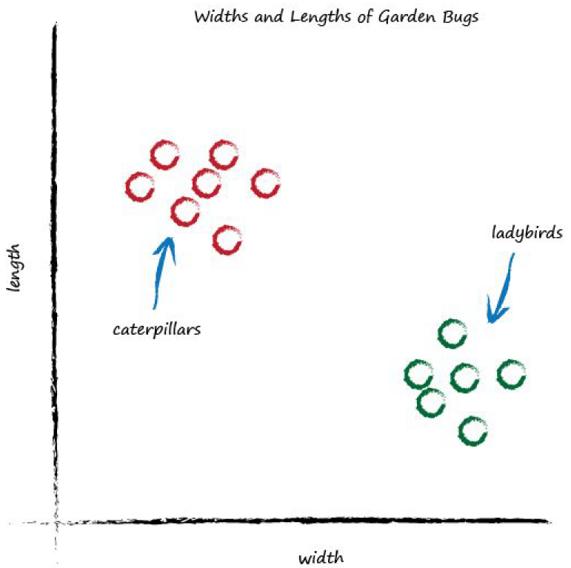
分類器
Caterpillars，thin and long
ladybirds，wide and short
What happens if we place a straight line over that plot?
we can use the line to separate different kinds of things

Slide 13
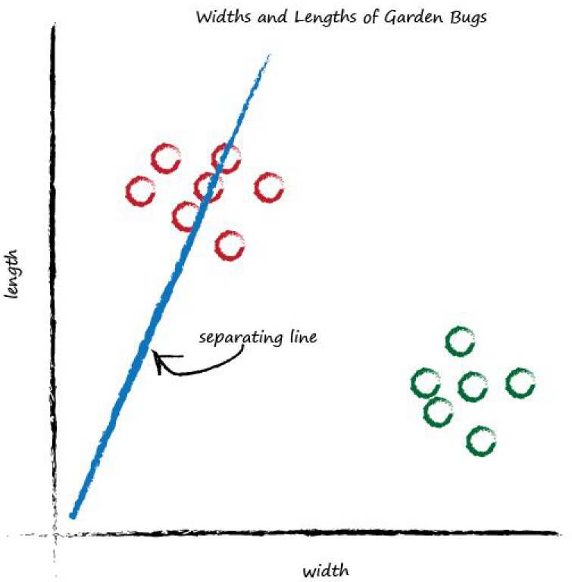
if the line was dividing the caterpillars from the ladybirds
it could be used to classify an unknown bug based on its measurements.
The line above doesn’t do this yet

Slide 14
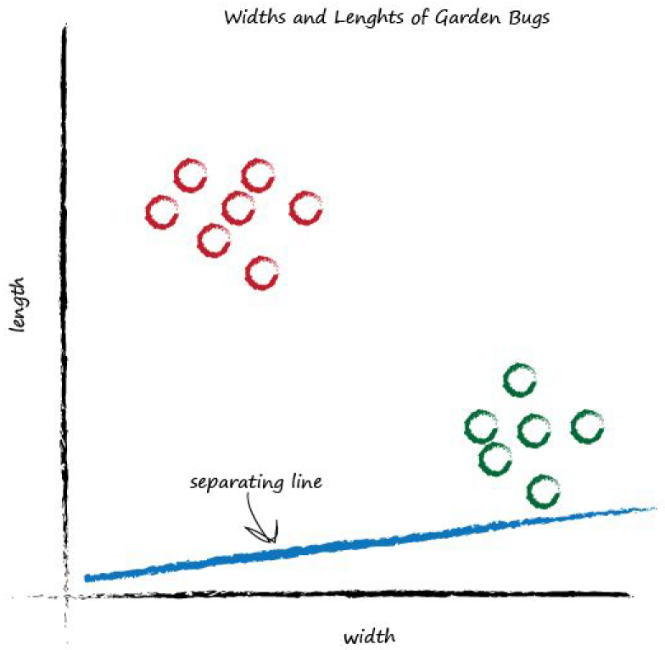
Let’s try a different line, by adjusting the slope again, and see what happens.
It doesn’t separate the two kinds of bugs at all.

Slide 15
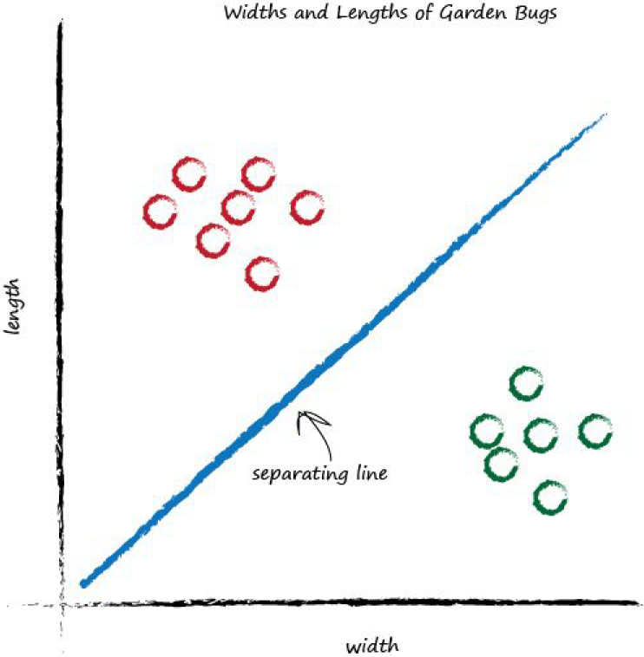
That’s much better
This line neatly separates caterpillars from ladybirds.
We can now use this line as a classifier of bugs.

Slide 16
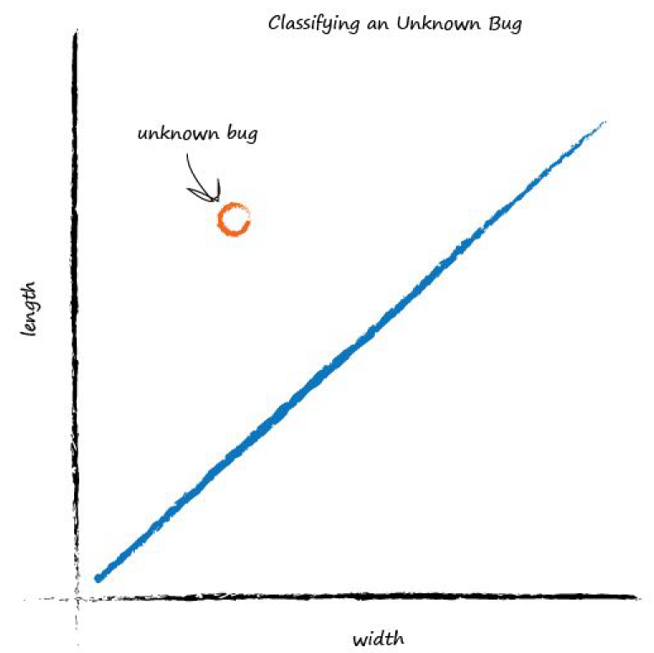
you can see the unknown bug is a caterpillar because it lies above the line.
This classification is simple but pretty powerful already!

Slide 17
如何訓練分類器?
Rather than develop some mathematical theory upfront
let’s try to feel our way forward by trying to do it.
摸著石頭過河
We’ll understand the mathematics better that way.

Slide 18
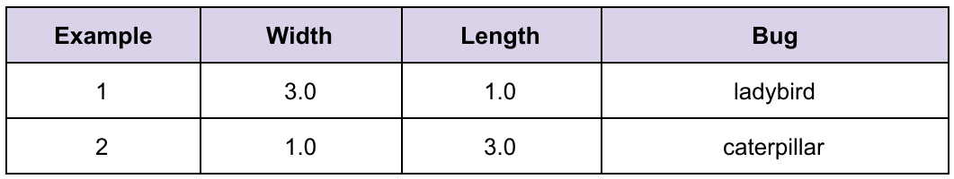
This is a set of examples which we know to be the truth.
It is these examples which will help refine the slope of the classifier function.
Examples of truth used to teach a predictor or a classifier are called the training data.

Slide 19
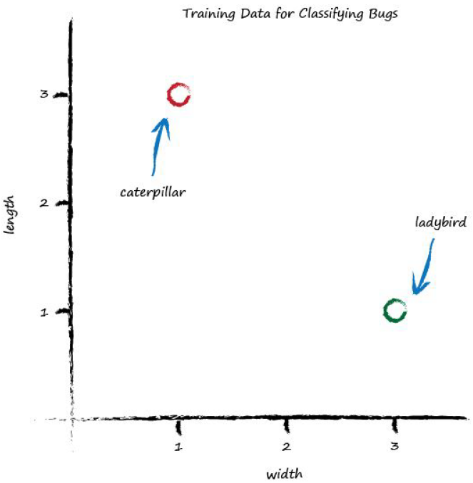
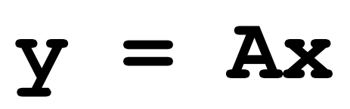
Let’s start with a random dividing line, just to get started somewhere.
we had a linear function whose parameter we adjusted

Slide 20
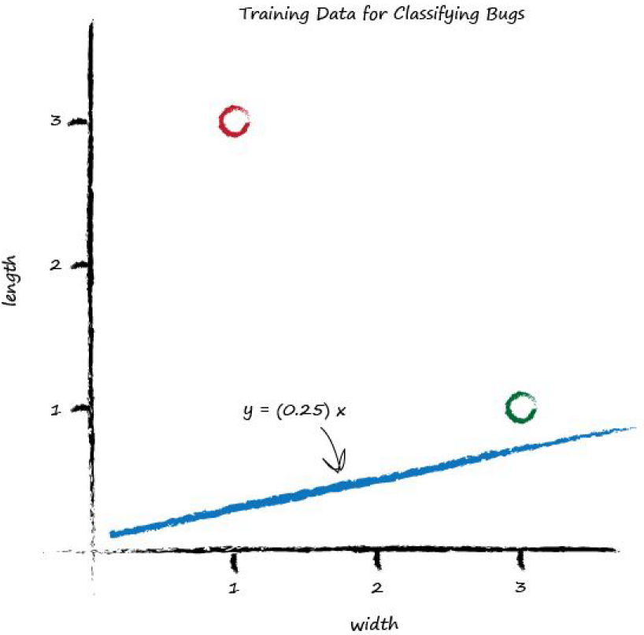
Let’s go for A is 0.25 to get started.
The dividing line is y = 0.25x.
it isn’t a good classifier
So intuitively we need to move the line up a bit.
We’ll resist the temptation to do this by looking at the plot and drawing a suitable line.

Slide 21
We want to see if we can find a repeatable recipe to do this, a series of computer instructions, which computer scientists call an algorithm.

Slide 22
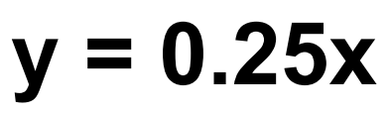
If we tested the function with example1, y = (0.25) * (3.0) = 0.75
a bug of width 3.0, the length should be 0.75.
The training data example tells us it must be a length of 1.0.
we have a difference, an error.

Slide 23
we can use this error to inform how we adjust the parameter A

Slide 24
let’s think about what y should be .
If y was 1.0 then the line goes right through the point
we don’t actually want that.
We want the line to go above that point.
we want all the ladybird points to be below the line, not on it.
The line needs to be a dividing line between ladybirds and caterpillars, not a predictor of a bug’s length given its width.

Slide 25
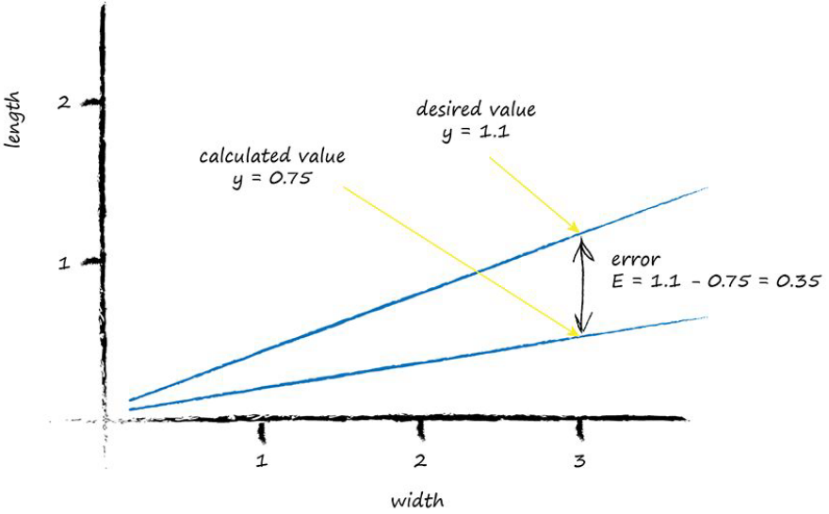
let’s try to aim for y = 1.1 when x = 3.0.
what do we do with this E to guide us to a better refined parameter

Slide 26
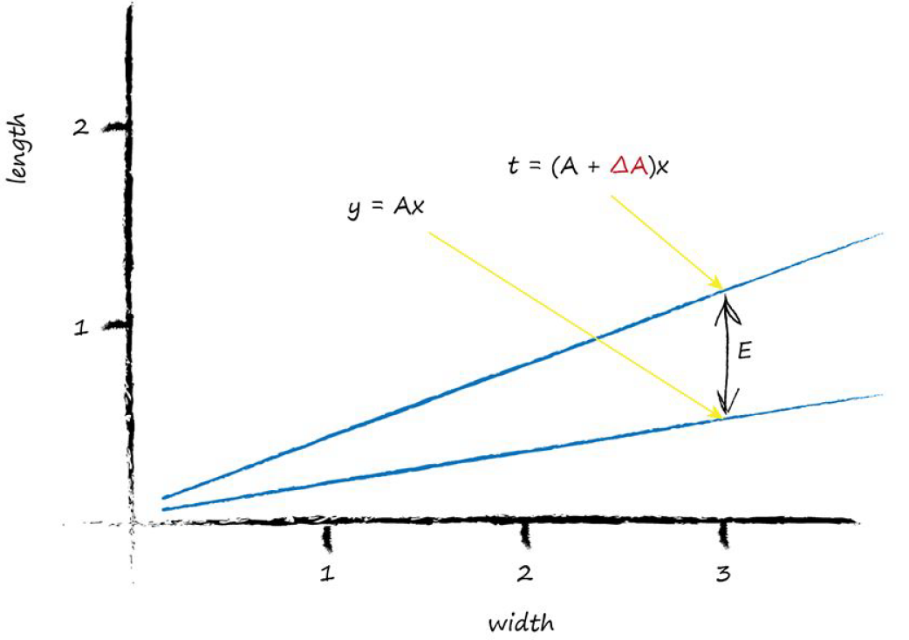
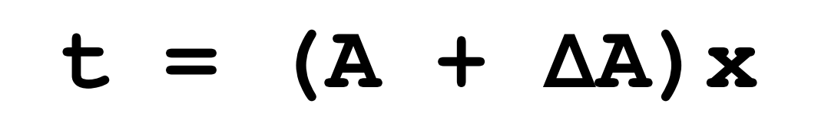
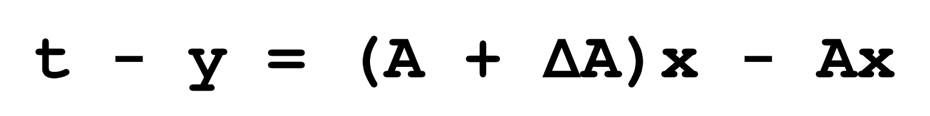
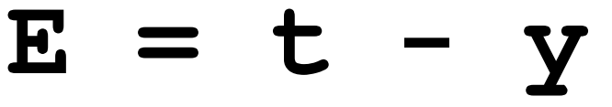
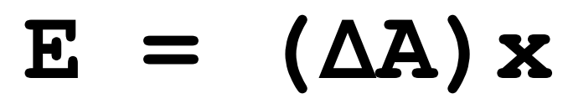
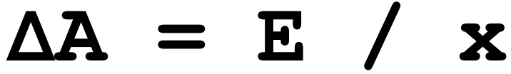

Slide 27
We can use the error E to refine the slope A of the classifying line
by an amount ΔA
The error was 0.35 and the x was 3.0.
That gives 0.35 / 3.0 = 0.1167.
change the current A = 0.25 by 0.1167.
the new improved value for A = (A + ΔA) is 0.25 + 0.1167 = 0.3667.
Now we’re done with one training example
let’s learn from the next one.

Slide 28
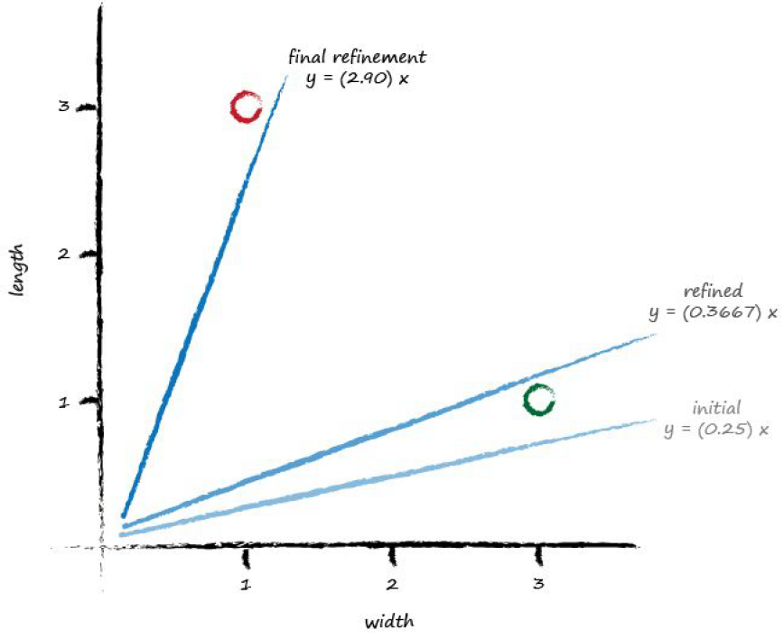
x = 1.0 and y = 3.0.
updated A = 0.3667
y = 0.3667 * 1.0 = 0.3667
set the desired value = 2.9
E is (2.9 - 0.3667) = 2.5333
ΔA is E / x = 2.5333 / 1.0
newer A is 0.3667 + 2.5333 = 2.9

Slide 29
we don’t seem to have improved the slope in the way we had hoped.
It hasn’t divided neatly the region
The line updates to give each desired value for y.
What’s wrong with that?
we are throwing away any learning that previous training examples might gives us
just learning from the last one.
How do we fix this?
We moderate the updates.
適度改進

Slide 30
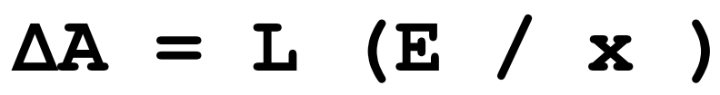
we calm them down a bit.
Instead of jumping to each new A,
we take a fraction of the change ΔA, not all of it.
使用這種方式，小心謹慎地向訓練樣本所指示的方向移動，保留先前訓練所得到的值的一部份。
This moderation, has another very powerful and useful side effect.
當訓練數據本身不能確信為完全正確，並且充滿錯誤、噪聲
有節制的調整可抑制或緩和錯誤、噪聲
we’ll add a moderation into the update formula:
Notes:
This way we move in the direction that the training example suggests, but do so slightly cautiously, keeping some of the previous value which was arrived at through potentially many previous training iterations.

Slide 31
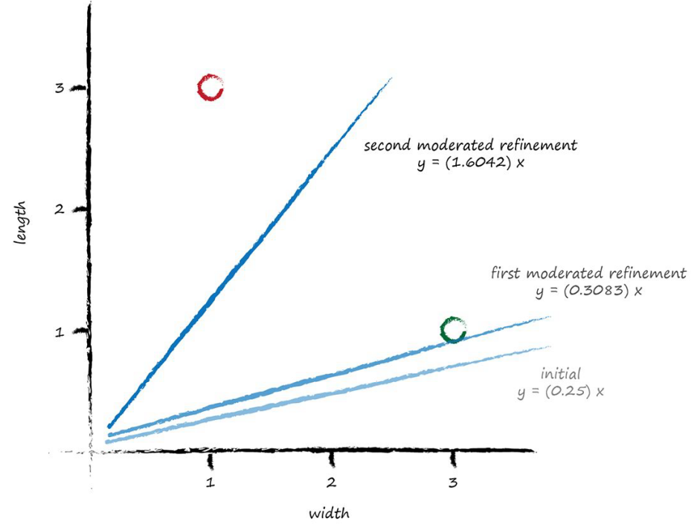
The learning rate , L
Let’s pick L = 0.5
A = 0.25, first training , y = 0.25 * 3.0 = 0.75
desired value 1.1 , error is 1.1 – 0.75 = 0.35
ΔA = L (E / x) = 0.5 * 0.35 / 3.0 = 0.0583
updated A is 0.25 + 0.0583 = 0.3083
Trying out this new A for x = 3.0
y = 0.3083 * 3.0 = 0.9250
line falls on the wrong side
It did move in the right direction

Slide 32
A = 0.3083 , second training , y = 0.3083 * 1.0 = 0.3083
desired value 2.9 , error is 2.9 - 0.3083 = 2.5917
ΔA = L (E / x) = 0.5 * 2.5917 / 1.0 = 1.2958.
newer A is now 0.3083 + 1.2958 = 1.6042.

Slide 33
Key Points:
用簡單的數學，說明線性分類器輸出誤差值和可調節斜率參數之間的關係，消除誤差值
樸素的調整方法，改進後的模型只和最後一次的訓練樣本匹配，忽略先前的訓練樣本。
使用學習率，調節改進速率(moderation)，使得單一樣本不再主導整個學習過程。
真實世界的訓練樣本可能充滿噪聲或包含錯誤
適度更新(moderation)有助於限制這些錯誤樣本的影響

Slide 34
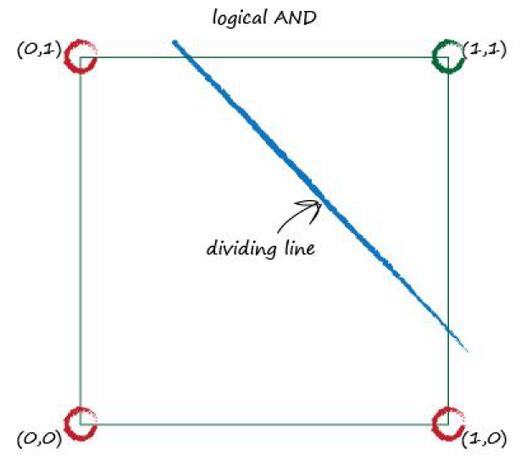
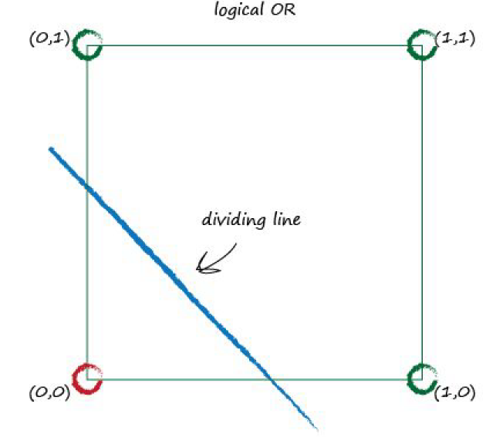
線性分類器的侷限性

Slide 35
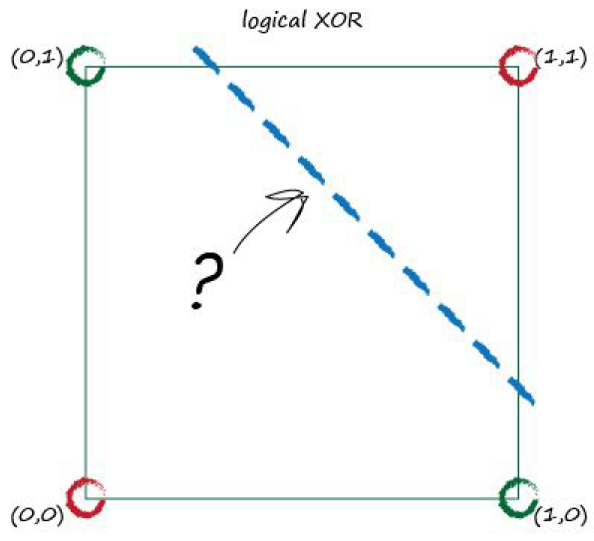
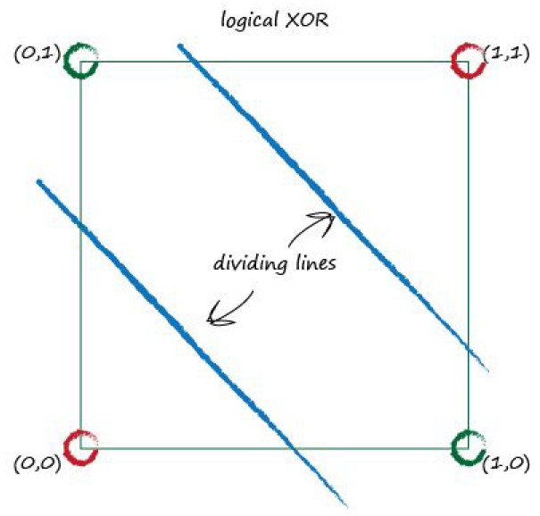

Slide 36
Key Points:
如果數據本身不是由單一線性過程支配，一個線性分類器無法對數據進行劃分
使用多個線性分類器

Slide 37
The complete functioning of brains is still a mystery
but enough is known about neurons
It takes an electric input, pops out another electrical signal
neurons don’t react readily , suppress the input
until it has grown so large that it triggers an output
a threshold must be reached before any output is produced
some kind of threshold is called an activation function

Slide 38
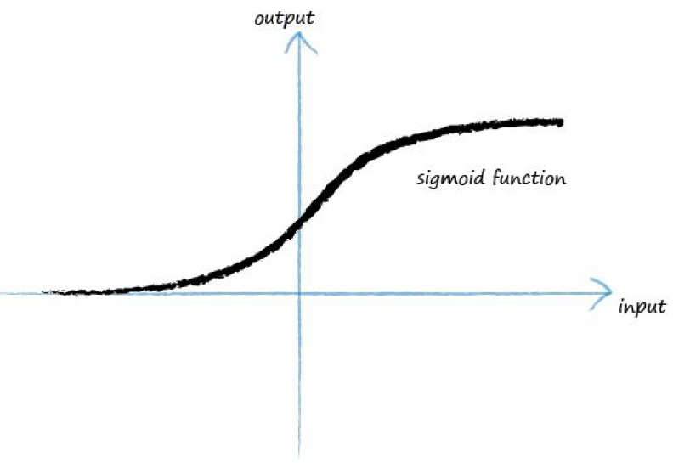
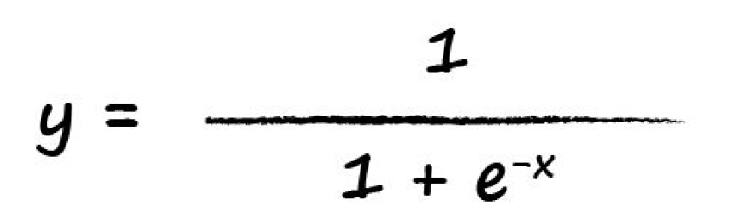

Slide 39
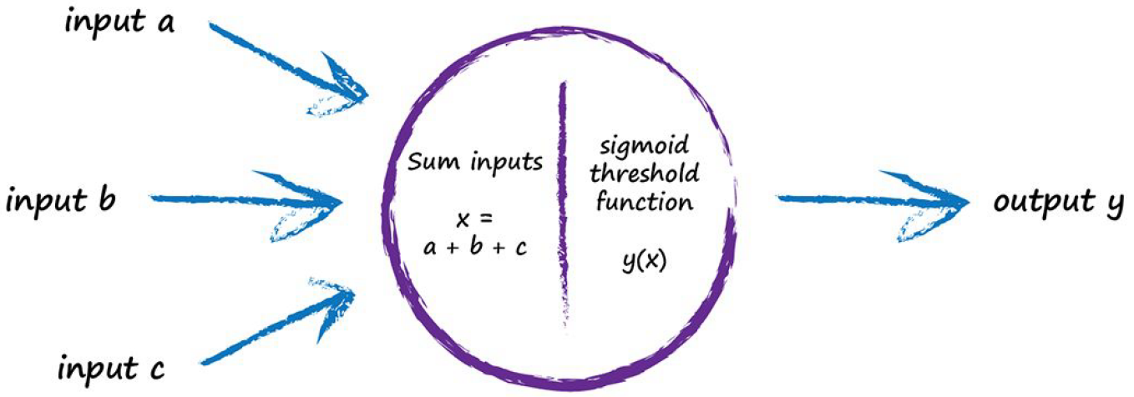
take many inputs, not just one
combine them by adding them up
the input to the sigmoid function
not large enough , suppress the output signal
large enough , fire the neuron

Slide 40
Interestingly, if only one of the several inputs is large and the rest small, this may be enough to fire the neuron.
What’s more, the neuron can fire if some of the inputs are individually almost, but not quite, large enough because when combined the signal is large enough to overcome the threshold.
In an intuitive way, this gives you a sense of the more sophisticated, and in a sense fuzzy, calculations that such neurons can do.

Slide 41
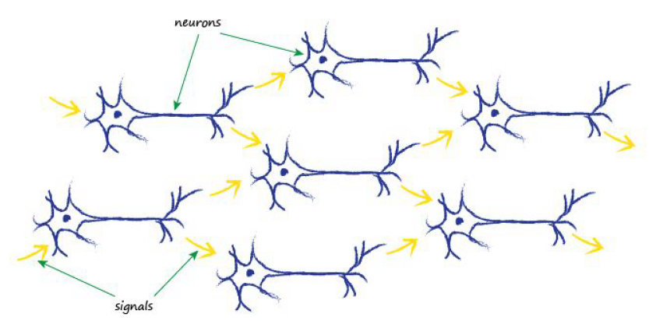
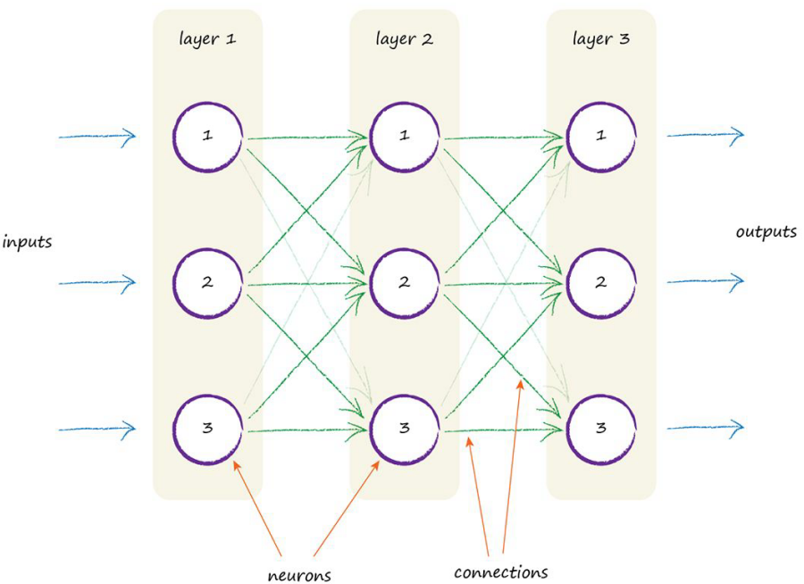

Slide 42
what part of this architecture does the learning?
What do we adjust in response to training examples?
Is there a parameter that we can refine like the slope of the linear classifiers we looked at earlier?

Slide 43
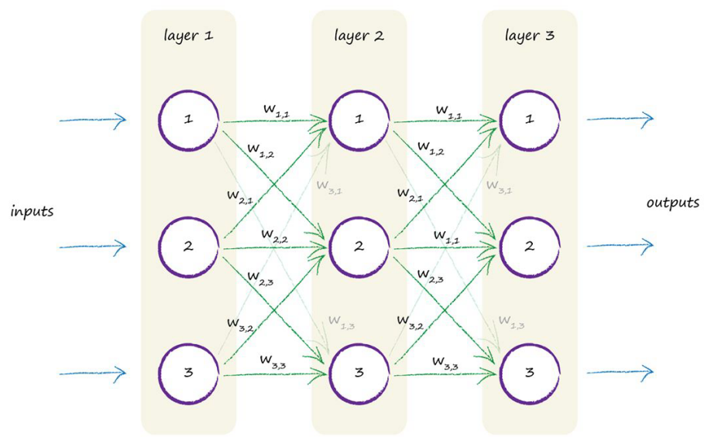
the strength of the connections between nodes , weight

Slide 44
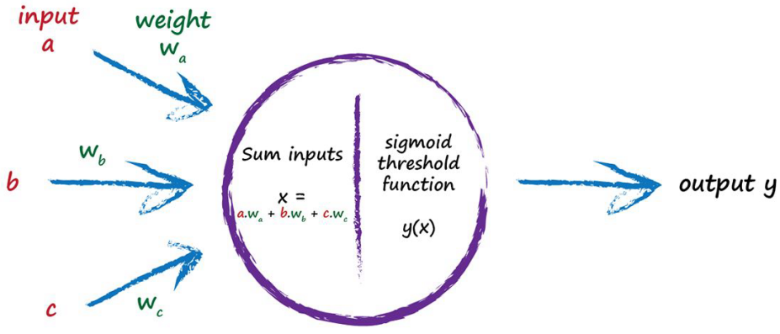

Slide 45
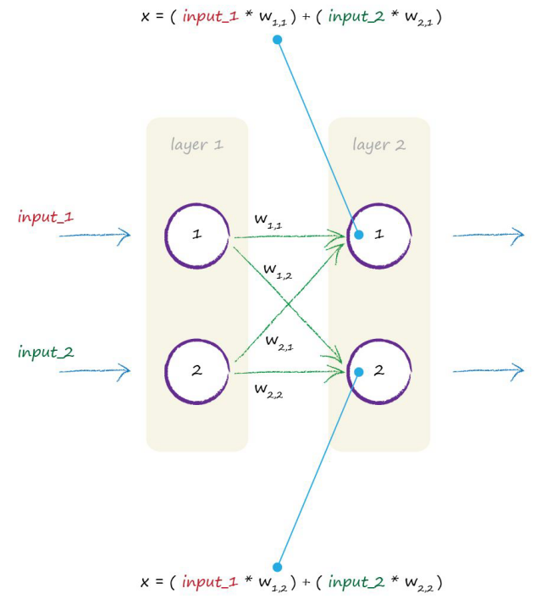
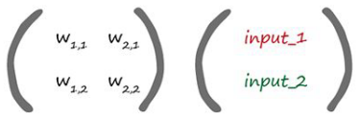
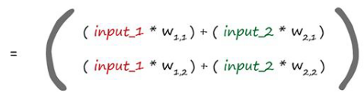

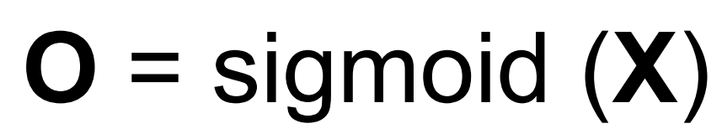

Slide 46
Key Points:
通過神經網路向前饋送信號所需的大量運算，都是矩陣乘法
無論神經網路規模
計算機可以高速高效進行這些計算

Slide 47
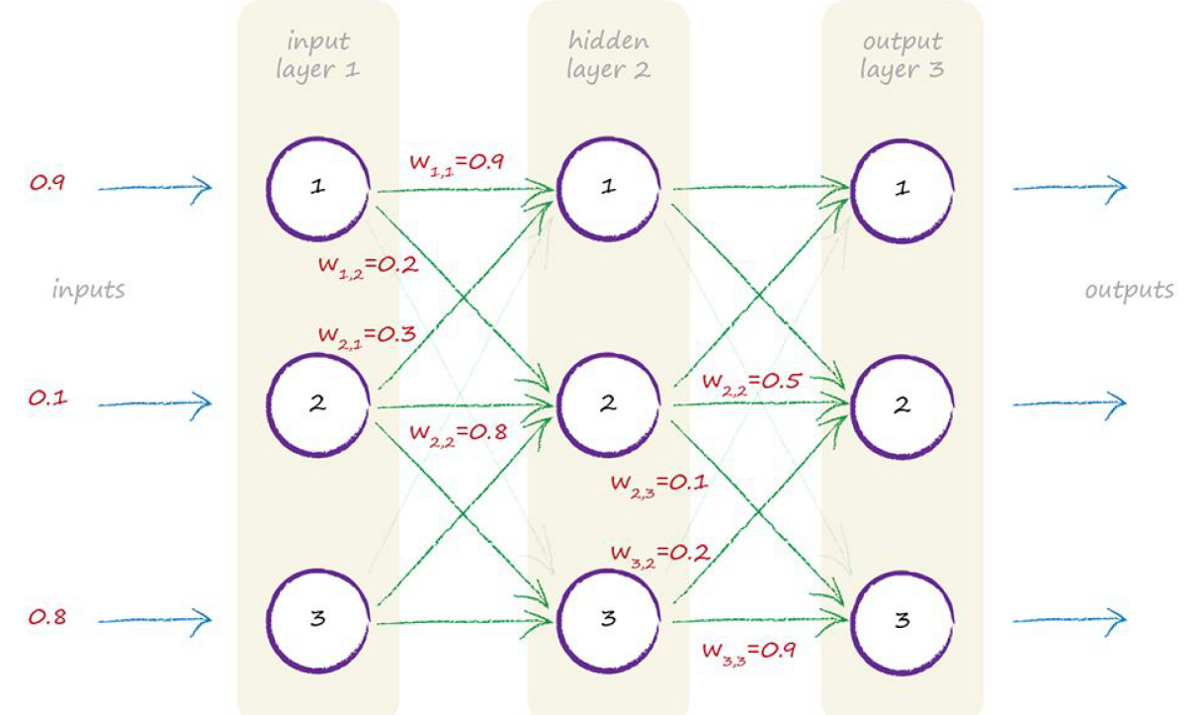
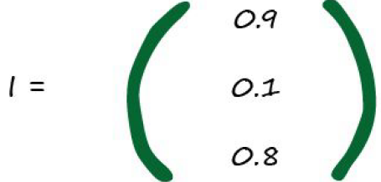
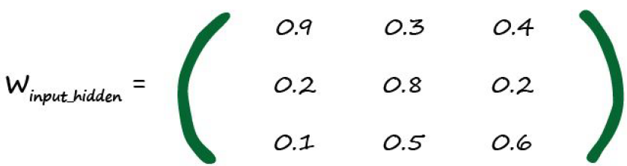
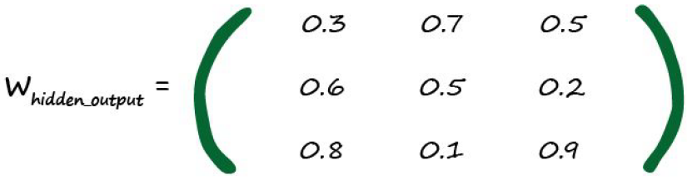
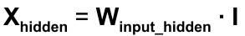
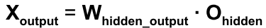
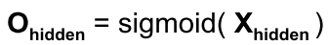
O_{output} = sigmoid( X_{output} )

Slide 48
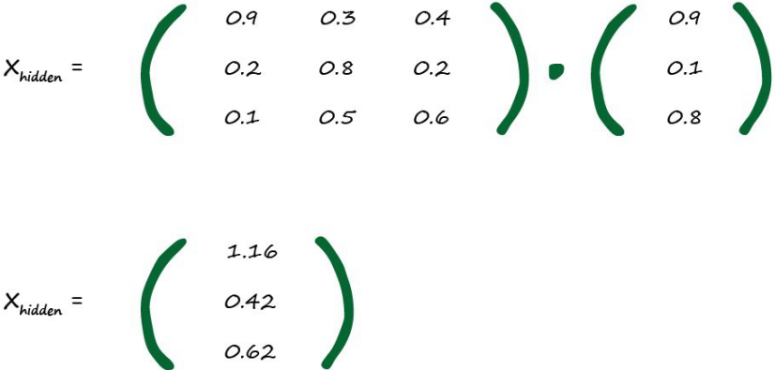
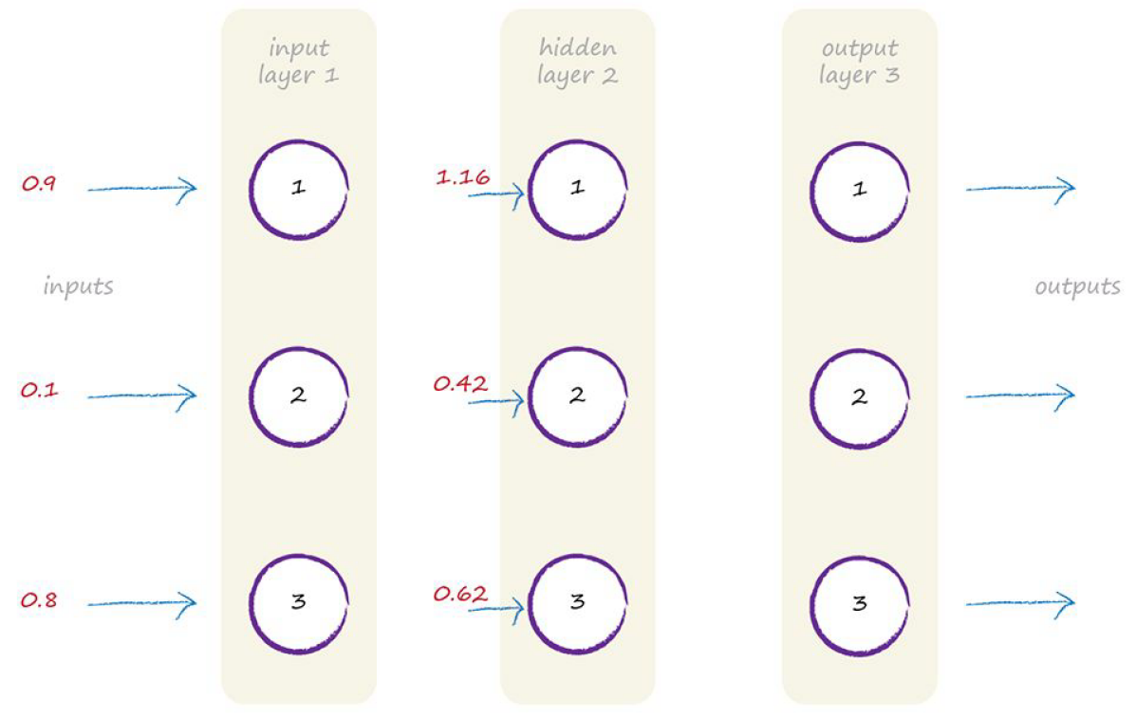

Slide 49
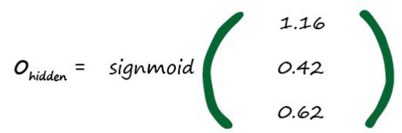
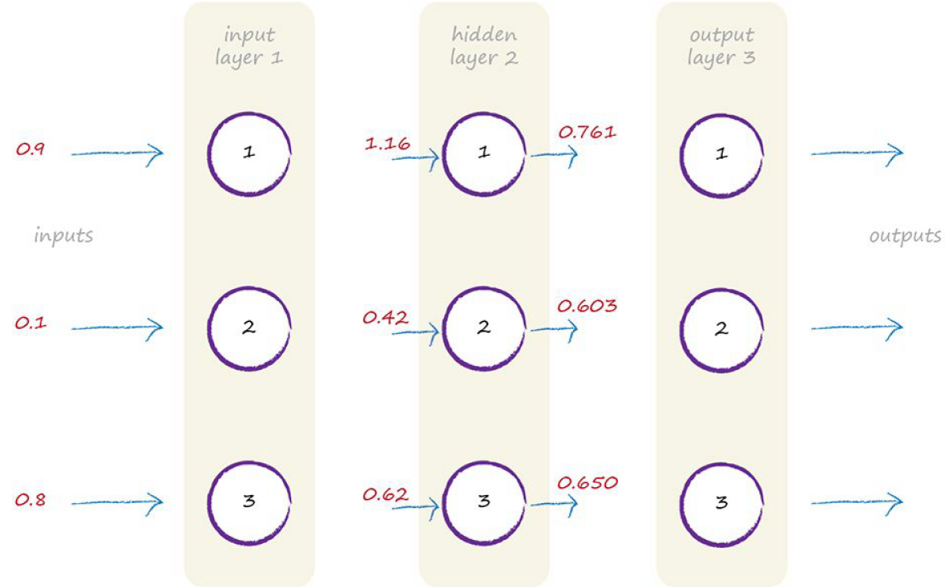


Slide 50



Slide 51


O_{output} = sigmoid( X_{output} )

Slide 52

先前，調整斜率，調整分類器
使用誤差值，引導調整
誤差與調整量的關係很單純
當輸出與誤差是多個節點共同作用的結果時，如何調整鏈結權重?

Slide 53


平分誤差
不等分誤差
為較大權重的鏈結分配更多誤差

Slide 54
兩種權重
第一種權重，將信號從輸入，向前傳播，到輸出層
第二種權重，將誤差從輸出，反向傳播，到網路

Slide 55




使用這兩個誤差，調整權重
按權重比例，分配誤差
對於第二個節點，重複
兩組鏈結不存在依賴關係

Slide 56

將誤差反向傳播到更多層
使用誤差e_{output}調整權重w_{ho}
將誤差值按權重比例進行分割

Slide 57

使用誤差e_{hidden}調整權重w_{in}
將誤差值按權重比例進行分割
只有最終輸出層的目標值，來自訓練樣本
隱藏層的輸出沒有目標值，如何計算誤差?

Slide 58


隱藏層第一個節點有兩個鏈接
這兩個鏈接將這個節點鏈接到兩個輸出層的節點
沿著各個鏈接可以分配誤差
使用誤差的反向傳播，為連接重組，分配的誤差
第一個隱藏層節點的誤差，是兩個分配誤差的和

Slide 59

1.5*(2/5) = 0.6，0.5*(1/5) = 0.1，0.1+0.6 = 0.7
1.5*(3/5) = 0.9，0.5*(4/5) = 0.4，0.9+0.4 = 1.3

Slide 60

0.7*(3/5) = 0.42，1.3*(1/8) = 0.1625， 0.42 + 0.1625 = 0.5825
0.7*(2/5) = 0.28，1.3*(7/8) = 1.1375， 0.28 + 1.1375 = 1.4175

Slide 61
Key Points:
神經網路通過調整連接權重進行學習
這種方式由誤差引導
誤差就是訓練數據所給出的正確答案與實際輸出的差值
但是，與內部節點相關聯的誤差，無法用同樣的方式給出
按照連接的權重，分配輸出層的誤差，在每個內部節點重組

Slide 62




去除分母的用意?
合理性?

Slide 63
最重要的是，輸出誤差與鏈接權重w_{ij}的乘法
較大的權重，攜帶較多的輸出誤差給隱藏層
分母只是歸一化因子
忽略這個因子，只是失去 the scaling of the errors being fed back
實踐證明，可以這樣做，效果一樣
即使反饋的誤差過大或過小，在下一輪的迭代，網路自行糾正
鏈接權重的強度，給出共享誤差的最好指示
反饋的誤差應該遵循鏈接權重的強度

Slide 64
Key Points:
反向傳播誤差可以表示為矩陣乘法
無論網路規模大小，都能夠簡潔表示反向傳播誤差
計算機可以更高效的完成工作
向前饋送信號、反向傳播誤差，都是矩陣乘法

Slide 65
實際上如何更新權重
到目前為止，已經理解了讓誤差反向傳播到網路的每一層
使用誤差來指導鏈接權重的調整，改進神經網路輸出的答案
這就是先前所討論的線性分類器做的事情
但這些節點不是線性分類器
這些節點，稍微複雜，先對加權的信號求和，並應用sigmoid函數
如何才能真正的更新，這些非線性節點之間，鏈接的權重?
梯度下降

Slide 66
Imagine a very complex landscape
It’s dark and you can’t see anything
you’re on the side of a hill and you need to get to the bottom
You don’t have an accurate map
You do have a torch
What do you do?

Slide 67
You’ll probably use the torch to look at the area close to your feet
You can’t see much further anyway
You can see which bit of earth seems to be going downhill
take small steps in that direction
you slowly work your way down the hill, step by step
without having a full map
without having worked out a journey beforehand
The mathematical version of this approach is called gradient descent

Slide 68

imagine that complex landscape is a mathematical function.
gradient descent method
an ability to find the minimum
without understanding that complex function fully

Slide 69
梯度下降法和神經網路之間有什麼關係
網路誤差就是複雜困難的函數
找到最小值，最小化誤差，改進網路輸出

Slide 70

假裝這是一個複雜的函數
找一個起點，隨機
觀察，哪裡往下
標記斜率，當前為負
沿向下方向，右
稍微增加x的值
向最小值靠近了一點

Slide 71

換一個起點
斜率為正，左邊是下面
稍微減小x
向最小值靠近了一點

Slide 72

要改變步子的大小，避免超調，在最小值附近來回反彈
調整步長，與梯度的大小成比例
接近最小值，斜率平緩，採用小步長

Slide 73
即使不精確計算出斜率，也可以估計出斜率
往正確方向移動時，這種計算也很有用
當函數有很多參數時，這種方法才真正顯現亮點
神經網路的誤差函數取決於許多權重參數

Slide 74

複雜的函數有很多山谷
有可能卡在錯誤的山谷
從不同的起點開始
多次訓練網路
不同的起點，代表不同的起始參數。
在神經網路，這代表不同的起始鏈接權重

Slide 75

三種不同的嘗試，其中一種終止於錯誤的山谷

Slide 76
Key Points:
梯度下降法是求解函數最小值的一種方式
當函數非常複雜，無法輕易求解時，發揮很好的作用
當函數有很多參數，其他方法不切實際，這種方式依然適用
可以容忍不完善的數據
如果不能完美描述函數，或偶爾意外走錯一步，也不會錯得離譜

Slide 77
神經網路的輸出是一個極度複雜的函數
有許多鏈接權重。梯度下降，正確權重?
合適的誤差函數?
神經網路本身的輸出，不是。
目標訓練值與實際輸出值之間的差值

Slide 78

三種誤差
第一種，正負誤差抵銷，沒有反映實際情形
第二種，在最小值附近不連續，會來回跳動
第三種
容易計算斜率
平滑、沒有間斷、跳躍
越接近極值，梯度越小

Slide 79
有沒有第四種，有
可以構造各種各樣、複雜的、有趣的代價函數(cost functions)
代價函數(cost functions) = 誤差函數( error function)
有些可能完全行不通
有些可能針對特定問題有奇效
有些可能有作用，但太複雜而不值得

Slide 80

我們希望最小化的是神經網路的誤差函數
我們試圖優化的參數是網路鏈接權重
神經網路誤差 vs 一個權重

Slide 81


神經網路誤差 vs 兩個鏈接權重
當權重改變時，誤差如何改變

Slide 82


展開誤差函數
對目標值和實際值之差的平方求和
針對所有n個輸出節點的和

Slide 83

a node k, the output o_{k} only depends on weights w_{jk} , links into node k
remove all the o_{n} from that sum except w_{jk} links to , that is o_{k}

Slide 84
什麼意思?
也就是說，雖然針對所有的n個輸出求和才是總誤差
但計算，總誤差針對”某個權重”的變化，不需要把誤差給加總
誤差函數不需要對所有的輸出節點加總
節點的輸出只取決於所鏈接的權重

Slide 85


t_{k} is truth examples
it doesn’t vary as w_{jk} varies.

Slide 86



o_{k} is the output of the node k
the sigmoid function applied to the weighted sum of the connected incoming signals

Slide 87






Slide 88

為什麼去掉2?
不重要，只要方向正確，即使有誤差，也只是多迭代幾次
誤差可能本來也不小，不差那一點

Slide 89
這是訓練神經網路的關鍵，優化隱藏層與輸出層之間的權重
第一部份，最後一層節點k的 (目標值 – 實際值 )
第二部分，sigmoid函數，其中的求和表達式就是進入最後一層節點k的信號，i_{k}
第三部份，前一層隱藏節點j的輸出

Slide 90

為輸入層和隱藏層之間的權重找到類似的誤差斜率
第一部分的(目標值 – 實際值 )變成隱藏層節點中重組的向後傳播誤差
第二部分的sigmoid，內部的求和表達式，是前一層進入隱藏層中第j個節點的輸入，i_{j}
第三部份變成第一層的第i個節點的輸出，就是輸入信號

Slide 91

權重改變的方向與梯度方向相反
使用學習因子，alpha，調整變化
避免被錯誤的訓練樣本拉得太遠
保證權重不會由於持續超調，而在最小值附近來回擺動
誤差斜率，取負號，調整舊的權重，得到更新後的權重
斜率為正，減小權重；斜率為負，增加權重
適用於隱藏層和輸出層之間的權重
也適用於輸入層和隱藏層之間的權重

Slide 92

按照矩陣乘法的形式進行計算
上面的表示，為求簡潔，先省略學習因子alpha
權重改變矩陣中包含的值，用來調整權重
這個權重鏈接了當前層的節點與下一層的節點

Slide 93


Slide 94
Key Points:
神經網路的誤差是內部鏈接權重的函數
改進神經網路，意味著通過改變權重減小這種誤差
直接選擇合適的權重太難
通過誤差函數的梯度下降，採取小步長，迭代改進權重
每一步前進的方向，當前位置向下斜率最大的方向
用微積分很容易算出斜率
直接透過微積分計算極值也很難，但只是要算出當下的斜率很容易

Slide 95

Weight Update Worked Example

Slide 96

error e1 = 1.5
(2.0 * 0.4) + (3.0 * 0.5) = 2.3
1/(1 + e^-2.3 ) = 0.909
0.909*(1-0.909) = 0.083
The last part , o1 = 0.4
-1.5*0.083*0.4 = -0.0498
如果學習率為0.1
-(0.1*-0.0498) = 0.00498
2 + 0.00498 = 2.00498

Slide 97
準備資料
準備訓練數據
初始隨機權重
設計輸出值

Slide 98

如果輸入變大，激活函數會變得非常平坦
權重的改變取決於激活函數的梯度
小梯度意味著限制神經網路的學習能力
權重的變化也取決於輸入信號，故輸入也不能太小
0< x <1，ex: 0.01

Slide 99
神經網路的輸出是最後一層節點彈出的信號

